Slide 1

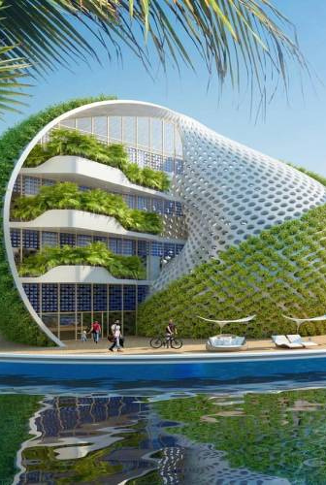

A construction company

Slide 2


1
Topic/Concept
Main focus of the Project.
Reason
2
TABLE OF
Problems and Solution.
CONTENT
Wire Frames
3
Sketch of the website.
Technologies Used
4
Codes and platforms.

Slide 3
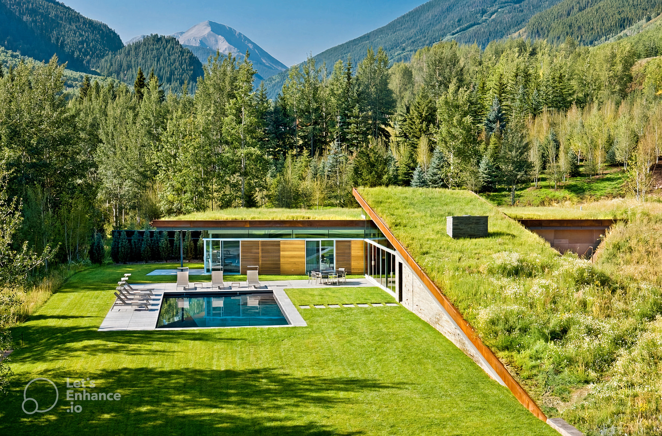
TOPIC/CONCEPT
Construction Company
-Cost effective architecture
Environmental Friendly
-Greener building practices
Promote Ecological Design
-Making use dull space for planting
Helping Our Planet

Slide 4
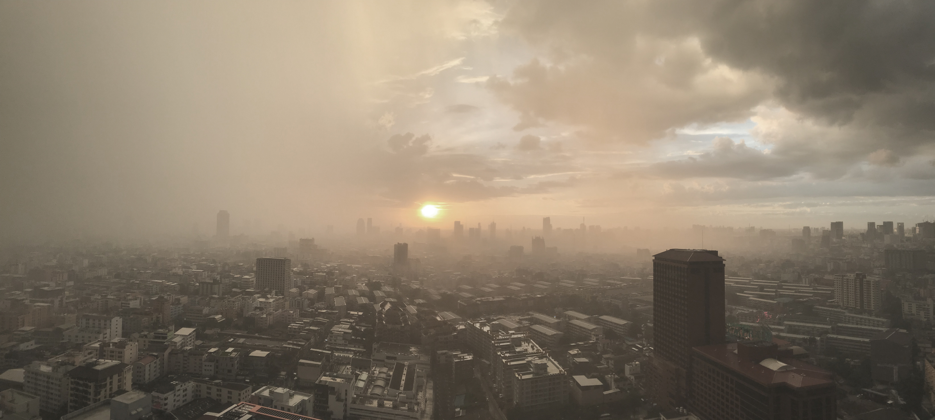
REASON
Air Pollution is like a dark cloud that harms the air we breathe and the water we drink. It's caused by things we do, like using too many cars and factories.
Trees can be our superheroes against pollution! Trees act like big sponges, soaking up bad stuff in the air and giving us fresh, clean air to breathe.

Slide 5
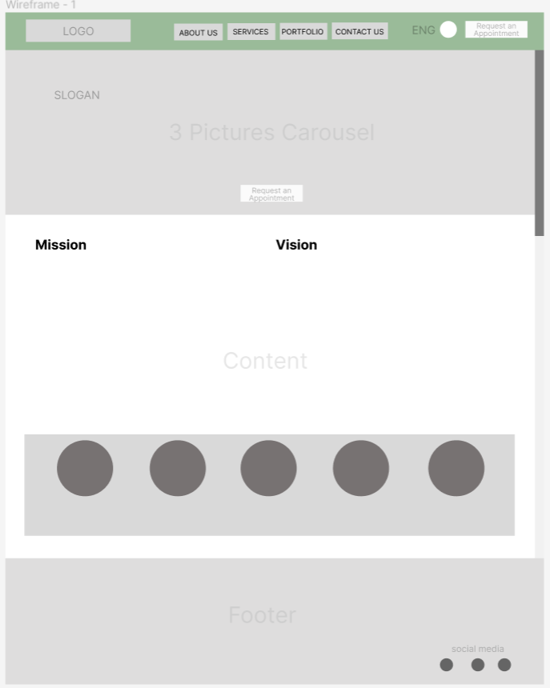
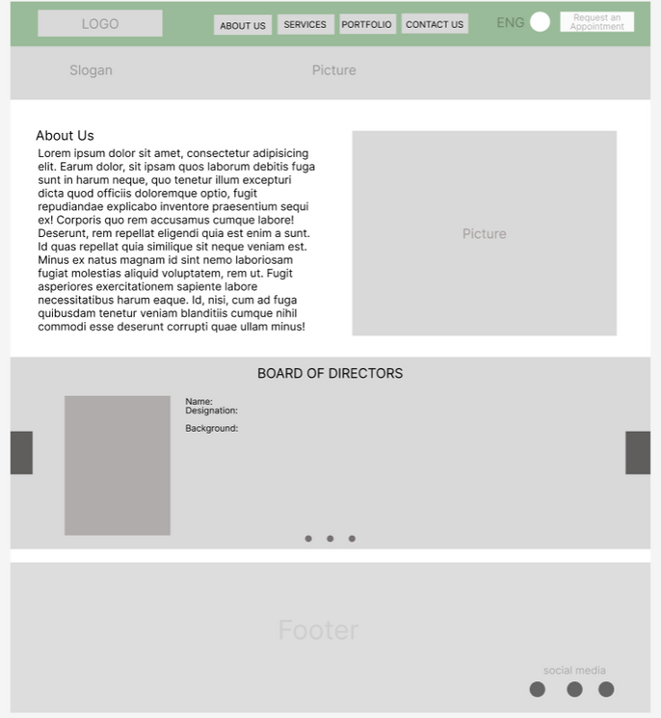
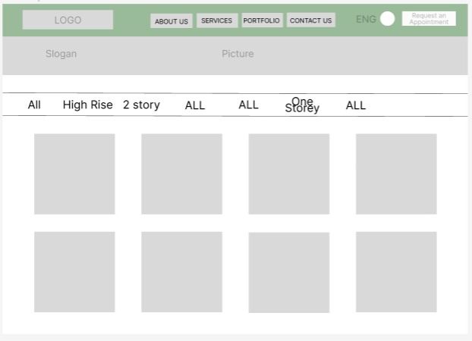
WIRE FRAMES

Slide 6

Technologies Used
HTML
CSS
Bootstrap
VS code
Git Bash
Git Hub
Figma
Canva

